Slide 1

Keep in Touch
Avi Hendler & Amit Tropp

Slide 2

Concept
An app that helps you stay in touch with the people you care about
By SMS/Whatsapp/Call
As often as you choose
At your convenience times
Using preset templates
Send manually pre-scheduled messages to any contact

Slide 3
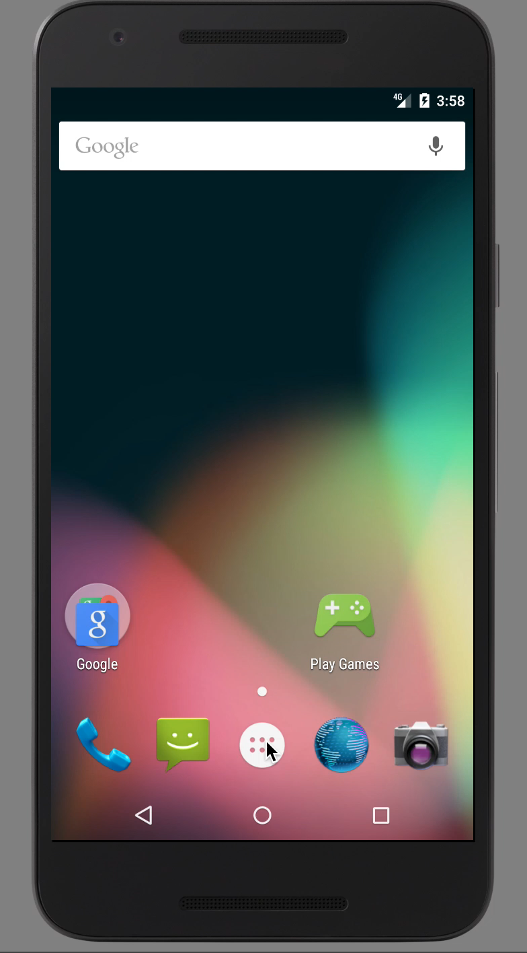
Demo

Slide 4
Technical Description
OOP:
abstract class
factories
singleton class
Usage of fragments for speed and tabs
AlarmManager – handle notifications when the app is closed
Usage of
smsManager for sending SMS
Intent for whatsapp and calls notifications

Slide 5
Q&A

